Slide 1
Data Mining 2 Supervised Learning
SUPPORT VECTOR MACHINES
Dr. Shailesh Kumar
ISB/CBA

Slide 2
Motivation

Slide 3
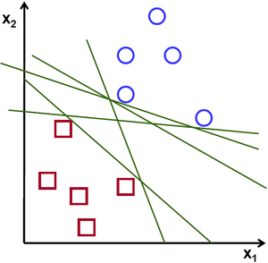
Which is the “best” Perceptron!

Slide 4
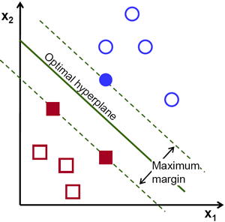
The “Best” Separation Boundary

Slide 5
Linear Support Vector Machines

Slide 6
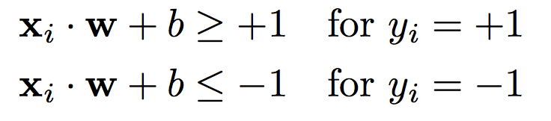

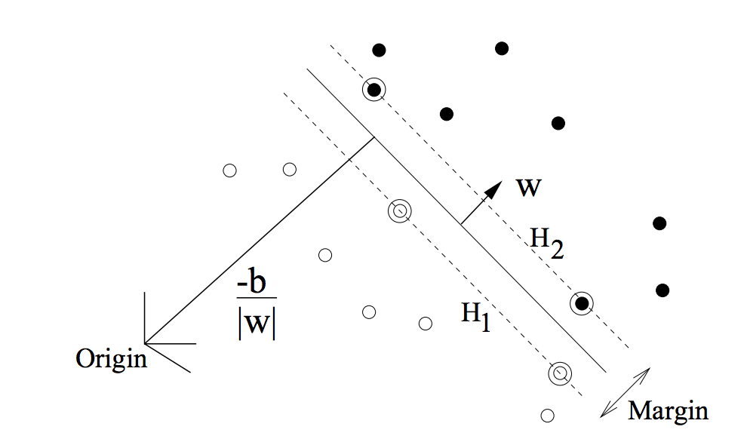
Linear Hyper-plane for 2-classes

Slide 7


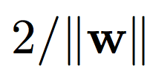
Linear Hyper-plane for 2-classes

Slide 8
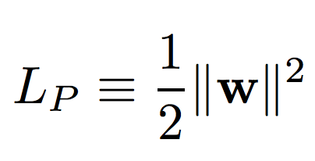
SVM Objective
OBJECTIVE:
CONSTRAINT:

Slide 9
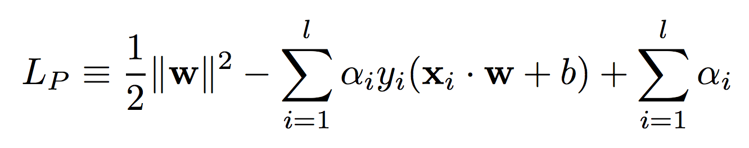
SVM Objective
OBJECTIVE:
CONSTRAINT:
Lagrange Multipliers

Slide 10
SVM Trick – 1 PRIMAL → DUAL

Slide 11
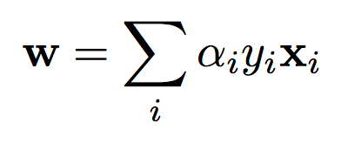
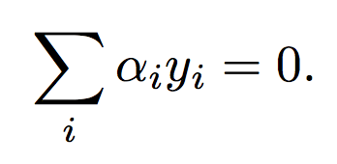
Solving the PRIMAL

Slide 12
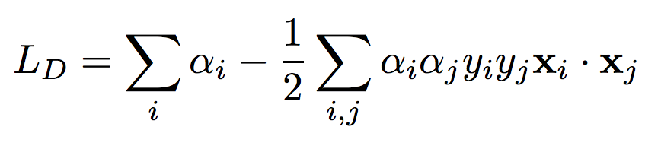
PRIMAL → DUAL

Slide 13
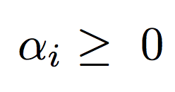
SVM Objective (DUAL)
OBJECTIVE: Minimize
CONSTRAINT:

Slide 14
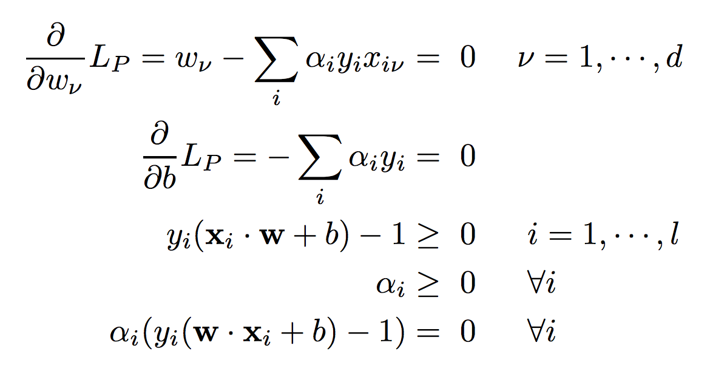
Karush-Kuhn-Tucker (KKT) condition

Slide 15
Support Vectors
Support Vectors

Slide 16
SVM Trick – 2 SLACK VARIABLES

Slide 17
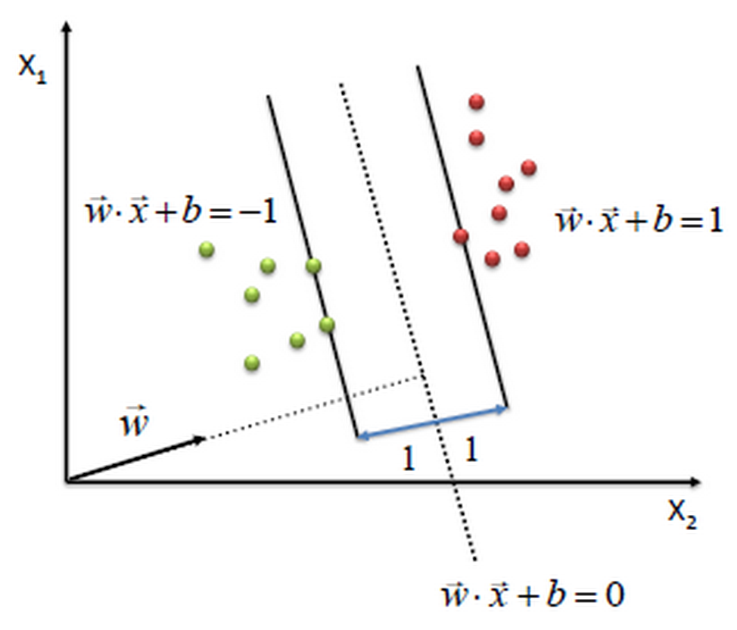
Separable Case

Slide 18
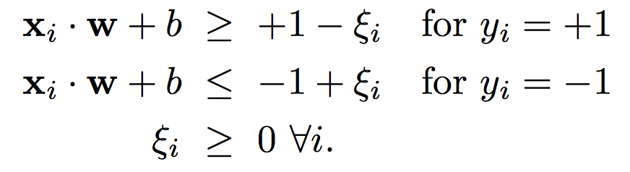
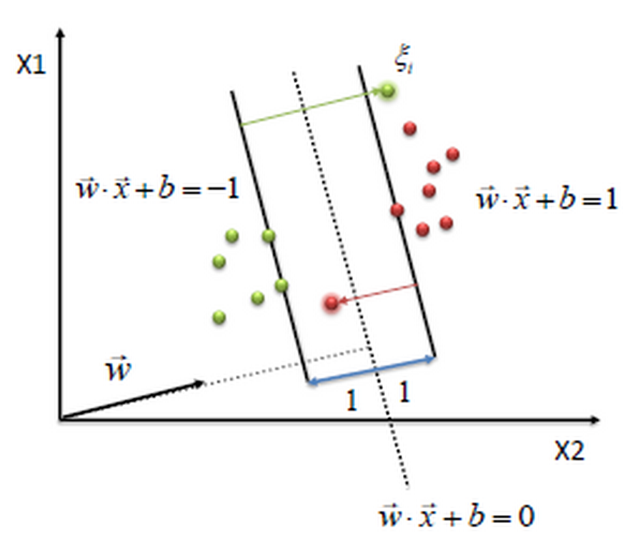
Non-Separable
Slack Variables

Slide 19
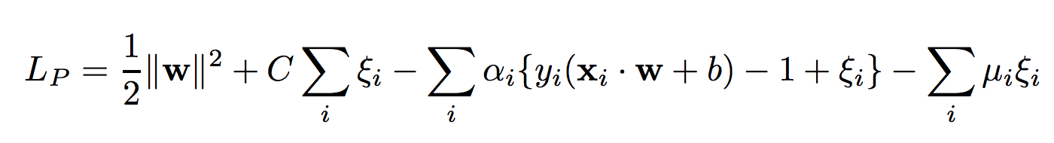
PRIMAL Objective
LINEARLY SEPARABLE CASE
LINEARLY NON-SEPARABLE CASE

Slide 20

DUAL Objective
LINEARLY SEPARABLE CASE
LINEARLY NON-SEPARABLE CASE

Slide 21
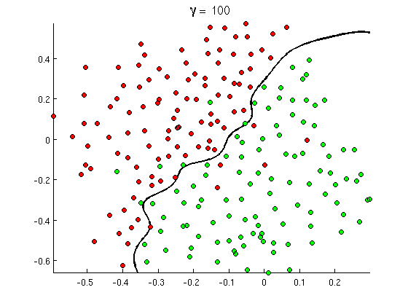
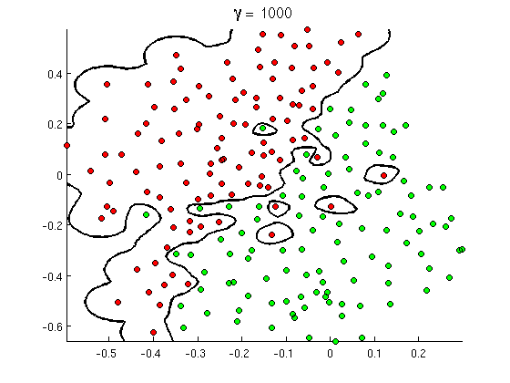
Tolerance for Slack → SVM Complexity

Slide 22
SVM Trick – 3 KERNEL TRICK

Slide 23
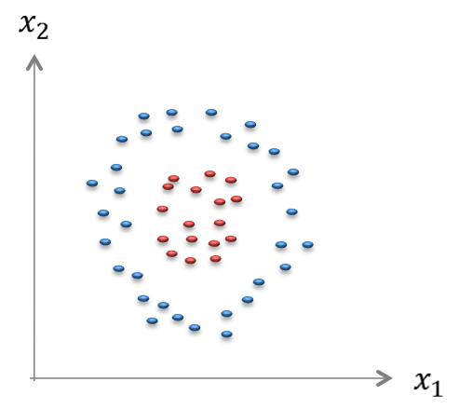
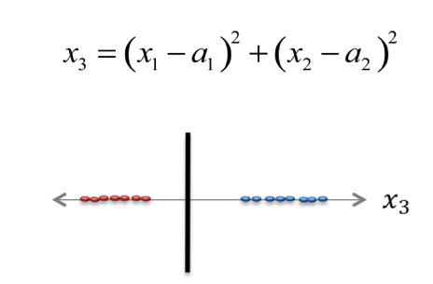
Feature Space Transformation
ORIGINAL FEATURE SPACE
Classes NOT LINEARLY SEPARABLE
TRANSFORMED FEATURE SPACE
Classes are LINEARLY SEPARABLE

Slide 24
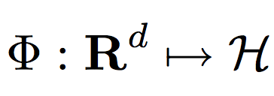
Increasing Model Capacity
LINEAR CLASSIFIERS
GENERALIZED LINEAR CLASSIFIERS

Slide 25
KERNEL TRICK

Slide 26
SVM Kernels
KERNEL FUNCTION

Slide 27
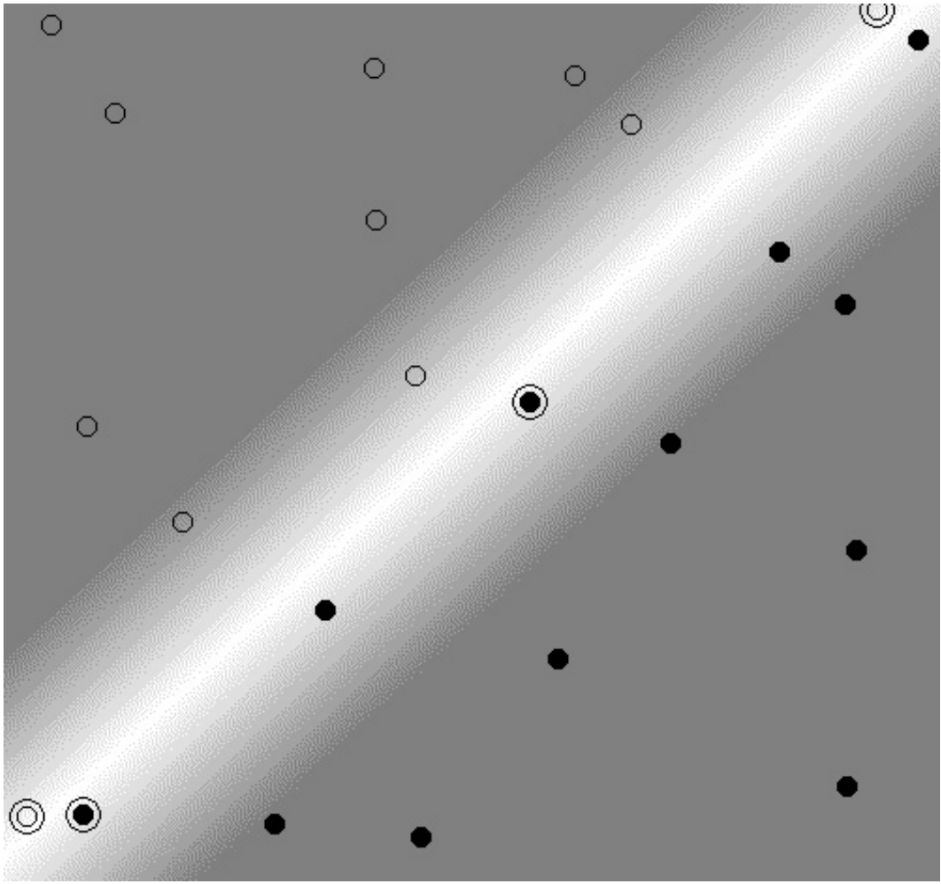
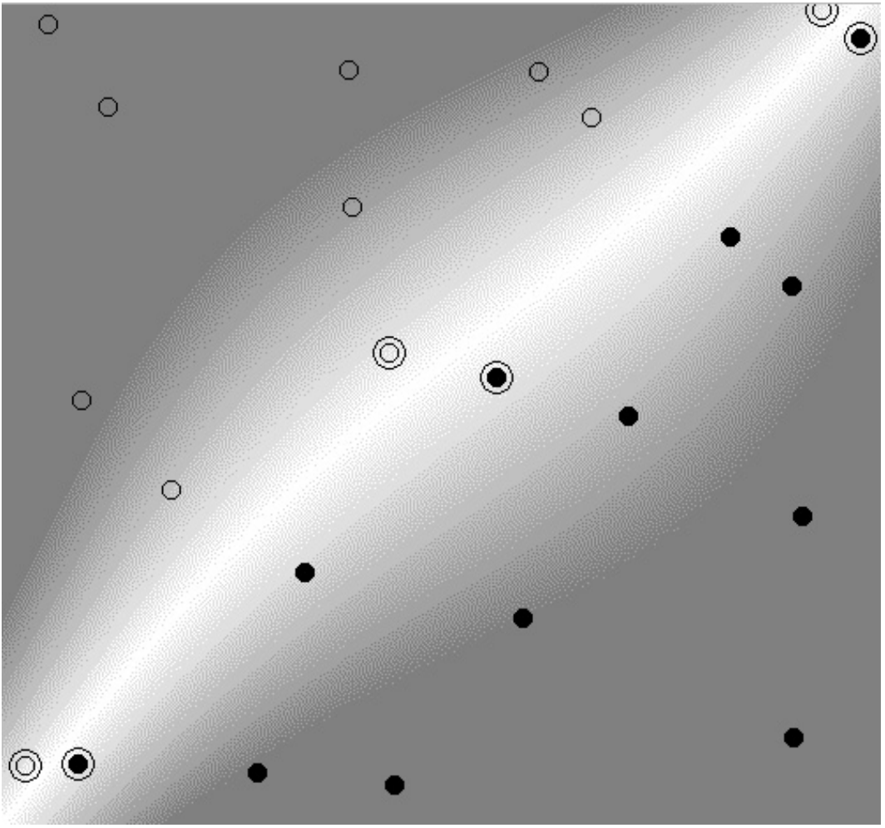
Polynomial Kernel / Separable

Slide 28
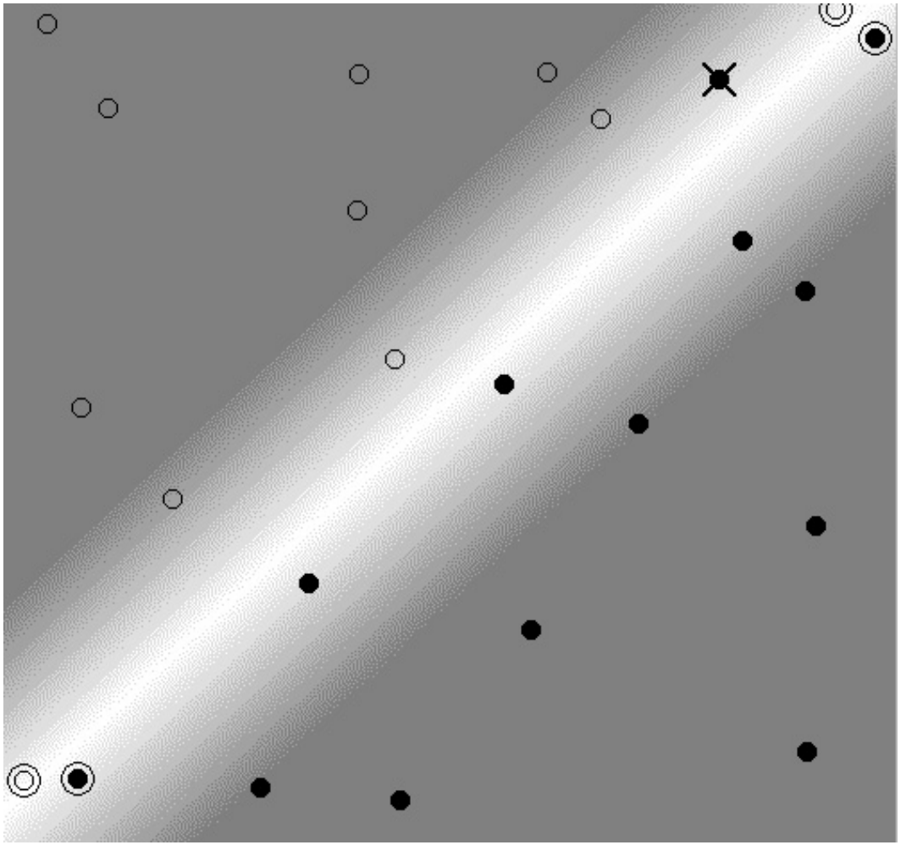
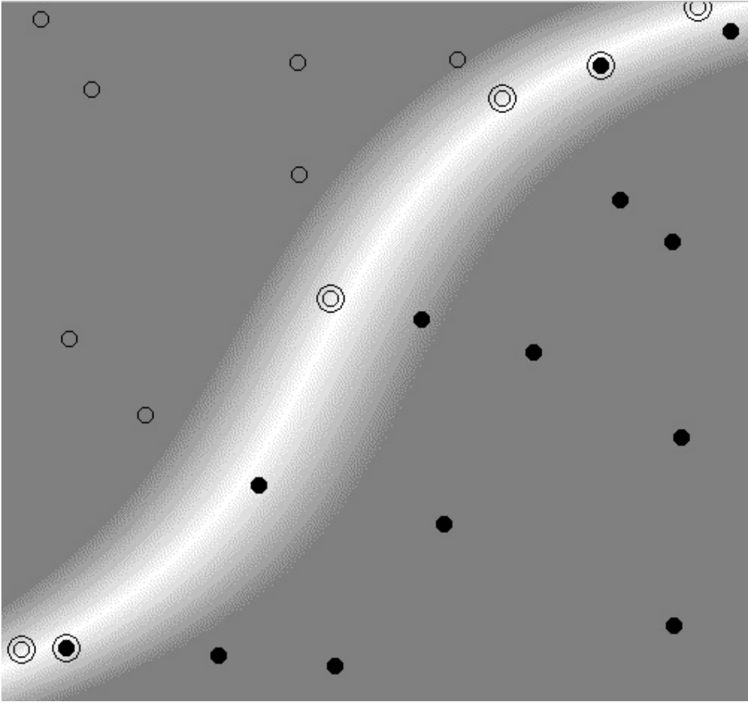
Polynomial Kernel / Non-Separable

Slide 29
Polynomial Kernel

Slide 30
RBF Kernels

Slide 31
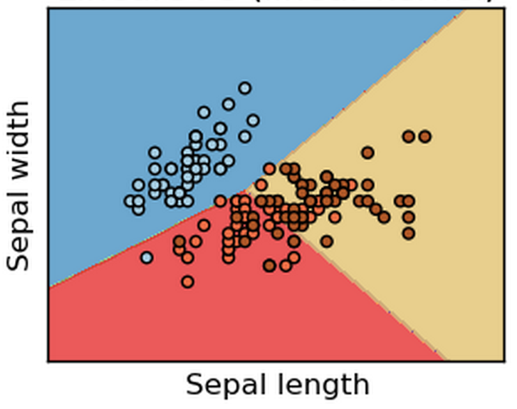
Linear SVM

Slide 32
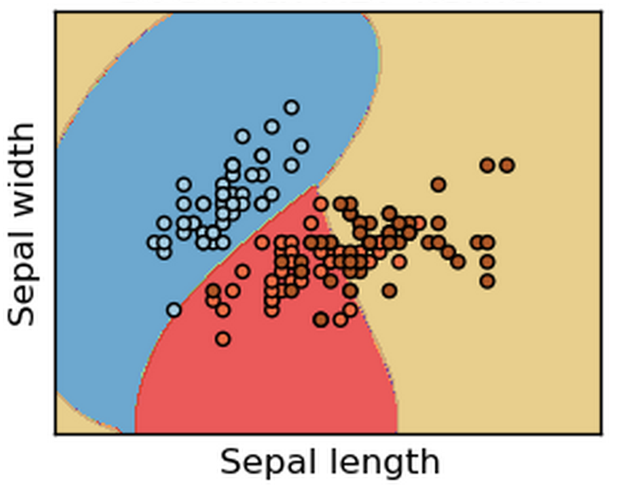
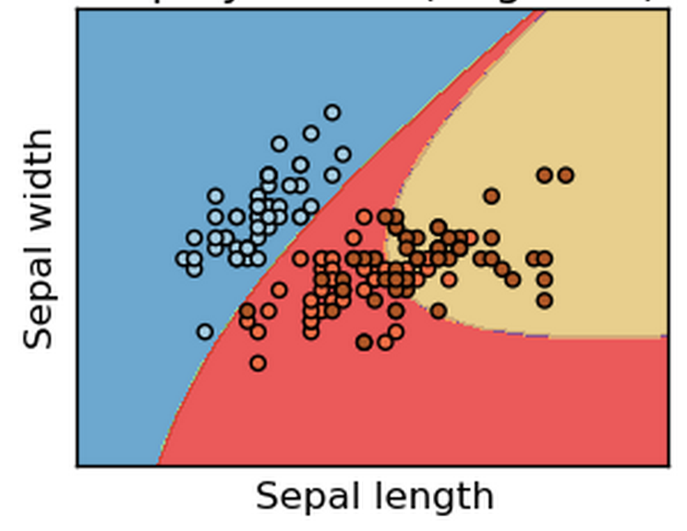
Non-Linear SVM

Slide 33
Summary in SVM
Learning an SVM Classifier
Trick 1 : PRIMAL → DUAL (Support Vectors)
Trick 2 : SLACK Variables
Trick 3 : Kernels
What kind of model is this?
What is the model?
What are the parameters?
What is complexity?
SCORING using SVM Classifier

Slide 34
Advanced Topics in SVM
More Kernels
Fisher Kernel
String Kernel
…
More Applications
SVM Regression
SVM based Outlier Detection
...
More Theory
VC Dimension
Probably Approximately Correct
…

